Slide 1


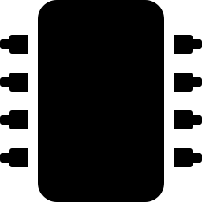

PHYSICAL AI BOOTCAMP
Meet MNIST: Teaching a Computer to Read Handwriting
A quick tour of the ideas behind this session’s notebook.
Notes:
Welcome! Today we're going to look under the hood of the MNIST notebook before running it. This is a quick 10-15 min conceptual primer.

Slide 2
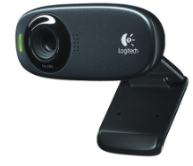
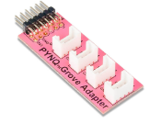
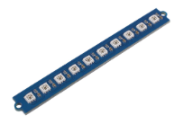
Today's Hardware
Three peripherals you'll connect to the board
USB Camera
PMOD (Peripheral Module) Adapter
RGB LED Stick
Captures a picture of your handwritten digit.
Connects small “Grove” peripherals to the board.
Lights up to show the model's predicted digit.
Notes:
Show the physical parts before booting the notebook, so students recognize them on the desk.

Slide 3
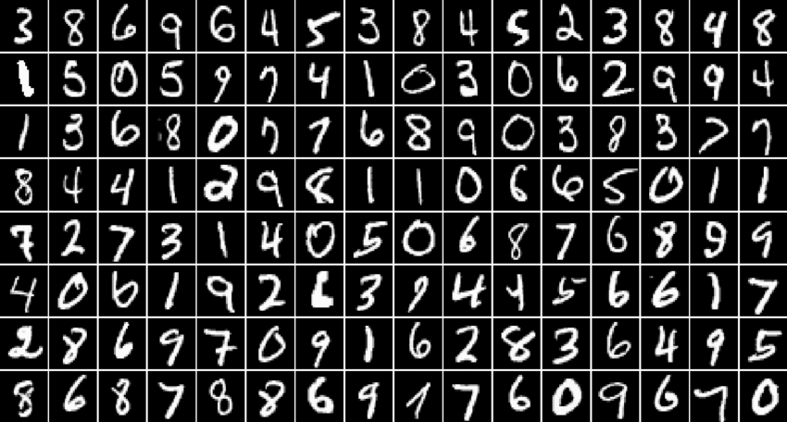

What is “Physical AI”?
AI that doesn't just live on a screen — it sees, hears, and reacts to the real world.
It has SENSORS
A camera to “see” your handwriting, just like eyes.
It has a BRAIN
A trained model that recognizes patterns — the FPGA does the thinking.
It ACTS in the real world
It lights up an LED to show its answer — not just text on a screen.
Today's example: a board that reads handwritten digits using a camera, a trained AI model, and an LED display.
Notes:
Physical AI = AI connected to sensors and actuators in the real world, not just a chatbot on a screen.

Slide 4
The MNIST Database
Intro to the world of machine learning
70,000
handwritten digit images (0–9)
28 x 28
pixels per image — tiny, but enough
10
possible answers: the digits 0 through 9
Notes:
MNIST is a huge collection of handwritten digits people wrote by hand, used to teach computers to recognize numbers. It's called the Hello World of ML because it's the classic first project.

Slide 5
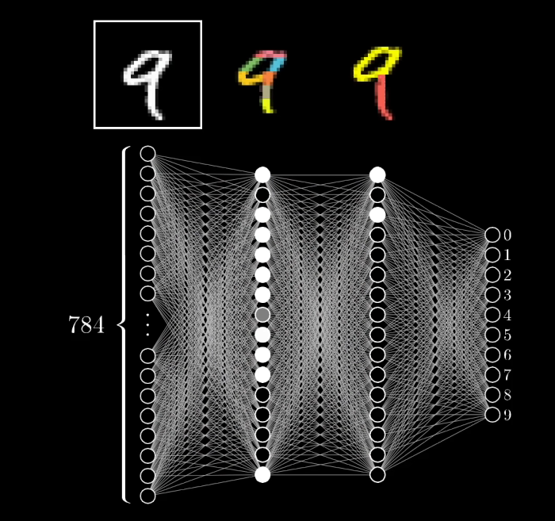
How does the computer “learn” to read digits?
1
It's called a CNN
Convolutional Neural Network — a program modeled loosely on how brains recognize patterns.
2
It studies thousands of examples
During training, it looks at labeled digits and adjusts internal “weights” until its guesses get better.
3
It's already trained for you
The model you'll use today already learned from the MNIST dataset — you're just asking it questions!
Notes:
The picture shows: input digit -> hidden layers of the network -> output guess (0-9). Emphasize the model is pre-trained; students are not training it live today.

Slide 6




Quick Vocab Check
Words you'll see pop up in the notebook today
FPGA (Field Programmable Gate Array)
DPU (Data Processing Unit)
Overlay
A reprogrammable chip — like circuits we can rewire with code instead of a soldering iron.
Data Processing Unit — the part of the FPGA built to run AI models fast.
The specific design we load onto the FPGA to make it act like a DPU.
CNN
Array
Softmax
Convolutional Neural Network — the model type that recognizes image patterns.
Another word for a list/grid of numbers — how images are stored.
Turns the model's raw output into probabilities for each digit, 0–9.
Notes:
Fast pass through vocabulary. Don't linger; tell them it's here for reference and in the notebook's cheat sheet too.

Slide 7
How confident is the model?
The model doesn't just say “7” — it gives a probability for every digit
86%
0
1
2
3
4
5
6
7
8
9
This is called SOFTMAX — it turns raw model output into probabilities that add up to 100%. The highest bar wins!
Notes:
Illustrative example only — not real output. Shows why softmax matters: the model's confidence, not just a single guess.

Slide 8
What we'll do in the notebook
Six steps from power-on to prediction
1
Load the overlay
2
Set up the LED stick
3
Load the model
Program the FPGA to become a DPU.
Get our “answer display” ready.
Bring in the pre-trained MNIST classifier.
4
Prep test images
5
Take a picture
6
See the prediction!
Normalize + reshape digit pictures.
Use the USB camera on your own handwriting.
Model guesses the digit; LED lights up to match.
Notes:
Walk through this quickly as a map of what's coming so nothing in the notebook feels random.

Slide 9
Quick Recap
MNIST + CNN
FPGA + DPU
Camera + LED
70,000 handwritten digits trained a model to recognize numbers 0–9.
Reprogrammable hardware runs the AI model super fast.
Physical AI: it sees your handwriting and shows its answer with light.
Questions before we dive into the notebook?
Notes:
Pause for questions here before switching over to the live notebook.

Slide 10

Let's Go!
Time to open the notebook, connect the hardware, and see your own handwriting classified in real time!
Notes:
Transition slide into opening the live PYNQ notebook.

